Slide 1
Chapter 6: Synchronization Tools

Slide 2
Process Synchronization
Background
The Critical-Section Problem
Synchronization Hardware
Semaphores
Classic Problems of Synchronization

Slide 3
Background
Concurrent access to shared data may result in data inconsistency
Maintaining data consistency requires mechanisms to ensure the orderly execution of cooperating processes
Classic problem – Producer & Consumer
Suppose that we wanted to provide a solution to the consumer-producer problem that fills all the buffers. We can do so by having an integer count that keeps track of the number of full buffers. Initially, count is set to 0. It is incremented by the producer after it produces a new buffer and is decremented by the consumer after it consumes a buffer.
Examples:
Data from bar-code reader consumed by device driver
Data in a file you want to print consumed by printer spooler, which produces data consumed by line printer device driver
Web server produces data consumed by client’s web browser

Slide 4
Producer
Consumer
while (true)
{
/* produce an item and put in nextProduced
while (count == BUFFER_SIZE)
; // do nothing
buffer [in] = nextProduced;
in = (in + 1) % BUFFER_SIZE;
count++;
}
while (true)
{
while (count == 0)
; // do nothing
nextConsumed = buffer[out];
out = (out + 1) % BUFFER_SIZE;
count--;
/*consume the item in nextConsumed
}
Are these code correct ???

Slide 5
Race Condition
count++ could be implemented as register1 = count register1 = register1 + 1 count = register1
count-- could be implemented as register2 = count register2 = register2 - 1 count = register2
Consider this execution interleaving with “count = 5” initially:
S0: producer execute register1 = count {register1 = 5} S1: producer execute register1 = register1 + 1 {register1 = 6} S2: consumer execute register2 = count {register2 = 5} S3: consumer execute register2 = register2 - 1 {register2 = 4} S4: producer execute count = register1 {count = 6 } S5: consumer execute count = register2 {count = 4}

Slide 6
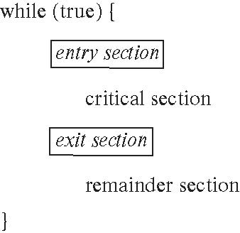
Critical Section Problem
Consider system of n processes {p₀, p₁, … p_{n-1}}
Each process has critical section segment of code
Process may be changing common variables, updating table, writing file, etc.
When one process in critical section, no other may be in its critical section
Critical section problem is to design protocol to solve this
Each process must ask permission to enter critical section in entry section, may follow critical section with exit section, then remainder section

Slide 7
Solution to Critical-Section Problem
1. Mutual Exclusion - If process P_{i} is executing in its critical section, then no other processes can be executing in their critical sections
2. Progress - If no process is executing in its critical section and there exist some processes that wish to enter their critical section, then the selection of the processes that will enter the critical section next cannot be postponed indefinitely
3. Bounded Waiting - A bound must exist on the number of times that other processes are allowed to enter their critical sections after a process has made a request to enter its critical section and before that request is granted
Assume that each process executes at a nonzero speed
No assumption concerning relative speed of the N processes

Slide 8
Synchronization Hardware
Many systems provide hardware support for critical section code
Uniprocessors – could disable interrupts
Currently running code would execute without preemption
Generally too inefficient on multiprocessor systems
Operating systems using this not broadly scalable
Modern machines provide special atomic hardware instructions
Atomic = non-interruptable
Either test memory word and set value – TestAndSet ()
Or swap contents of two memory words

Slide 9
TestAndSet Instruction
Definition:
boolean TestAndSet (boolean *target)
{
boolean rv = *target;
*target = TRUE;
return rv:
}
If *target = TRUE - > TestAndSet = TRUE; *target = TRUE
If *target = FALSE - > TestAndSet = FALSE; *target = TRUE

Slide 10
Solution Using test_and_set()
Shared boolean variable lock, initialized to false
Solution:
do { while (test_and_set(&lock))
; /* do nothing */
/* critical section */
lock = false;
/* remainder section */
} while (true);
Does it solve the critical-section problem?

Slide 11
Lock = False;
Process P1
Process P2
do { while (test_and_set(&lock))
; /* do nothing */
/* critical section */
lock = false;
/* remainder section */
} while (true);
do { while (test_and_set(&lock))
; /* do nothing */
/* critical section */
lock = false;
/* remainder section */
} while (true);
do { while (test_and_set(&lock))
; /* do nothing */
/* critical section */
lock = false;
/* remainder section */
} while (true);
If *lock = TRUE - > TestAndSet = TRUE; *lock = TRUE
If *lock = FALSE - > TestAndSet = FALSE; *lock = TRUE

Slide 12
Bounded Waiting with TestAndSet
Shared boolean variable lock, initialized to FALSE.
Solution for i th process ( total n number of processes) :
do { waiting[i] = True;
while ( waiting[i] &&TestAndSet (&lock ))
; /* do nothing
waiting[i] = False;
// critical section
j = ( i+1 ) % n ;
while ( (j!=i) && !waiting[j] )
j = (j+1) % n;
if ( j == i)
lock = FALSE;
else
waiting[j] = False;
// remainder section
} while ( TRUE);
 | i |  | j
Boolean array Waiting[ ]
With size of total number of processes

Slide 13
Swap Instruction
Definition:
void Swap (boolean *a, boolean *b)
{
boolean temp = *a;
*a = *b;
*b = temp:
}
Shared Boolean variable lock initialized to FALSE; Each process has a local Boolean variable key.
Solution:
do {
key = TRUE;
while ( key == TRUE)
Swap (&lock, &key );
// critical section
lock = FALSE;
// remainder section
} while ( TRUE);

Slide 14
Semaphore
Previous solutions are complicated and generally inaccessible to application programmers
OS designers build software tools to solve critical section problem
Synchronization tool that is easier to use than TestAndSet()
Semaphore S – integer variable
Two standard operations modify S: wait() and signal()
Originally called P() and V()
Less complicated
Can only be accessed via two indivisible (atomic) operations
wait (S) {
while S <= 0
; // no-op
S--;
}
signal (S) {
S++;
}

Slide 15
Semaphore as General Synchronization Tool
Counting semaphore – integer value can range over an unrestricted domain
Binary semaphore – integer value can range only between 0 and 1; simpler to implement
Also known as mutex locks
Can implement a counting semaphore S as a binary semaphore
Provides mutual exclusion
Semaphore S; // initialized to 1
wait (S);
Critical Section
signal (S);

Slide 16
Semaphore Implementation
Must guarantee that no two processes can execute wait () and signal () on the same semaphore at the same time
Thus, implementation becomes the critical section problem where the wait and signal code are placed in the critical section.
Could now have busy waiting in critical section implementation - Spinlock
But implementation code is short
Little busy waiting if critical section rarely occupied
Note that applications may spend lots of time in critical sections and therefore this is not a good solution.

Slide 17
Semaphore Implementation with no Busy waiting
With each semaphore there is an associated waiting queue. Each entry in a waiting queue has two data items:
value (of type integer)
pointer to next record in the list
Two operations:
block – place the process invoking the operation on the appropriate waiting queue.
wakeup – remove one of processes in the waiting queue and place it in the ready queue.

Slide 18
Semaphore Implementation with no Busy waiting (Cont.)
Implementation of wait:
wait (S){
value--;
if (value < 0) {
add this process to waiting queue
block(); }
}
Implementation of signal:
Signal (S){
value++;
if (value >= 0) {
remove a process P from the waiting queue
wakeup (P); }
}

Slide 19
Liveness
Processes may have to wait indefinitely while trying to acquire a synchronization tool such as a mutex lock or semaphore.
Waiting indefinitely violates the progress and bounded-waiting criteria discussed at the beginning of this chapter.
Liveness refers to a set of properties that a system must satisfy to ensure processes make progress.
Indefinite waiting is an example of a liveness failure.

Slide 20
Deadlock and Starvation
Deadlock – two or more processes are waiting indefinitely for an event that can be caused by only one of the waiting processes
Let S and Q be two semaphores initialized to 1
P₀ P₁
wait (S); wait (Q);
wait (Q); wait (S);
. .
. .
. .
signal (S); signal (Q);
signal (Q); signal (S);
Starvation – indefinite blocking. A process may never be removed from the semaphore queue in which it is suspended.
Priority Inversion – Scheduling problem when lower-priority process holds a lock needed by higher-priority process
Solved via priority-inheritance protocol

Slide 21
Classical Problems of Synchronization
Bounded-Buffer Problem
Readers and Writers Problem
Dining-Philosophers Problem

Slide 22
Bounded Buffer Problem
N buffers, each can hold one item
Semaphore mutex initialized to the value 1
Semaphore full initialized to the value 0
Semaphore empty initialized to the value N.
The structure of the producer process
do { // produce an item
wait (empty);
wait (mutex);
// add the item to the buffer
signal (mutex);
signal (full);
} while (true);
The structure of the consumer process
do {
wait (full);
wait (mutex);
// remove an item from buffer
signal (mutex);
signal (empty);
// consume the removed item
} while (true);

Slide 23
Readers-Writers Problem
A data set is shared among a number of concurrent processes
Readers – only read the data set; they do not perform any updates
Writers – can both read and write.
Problem – allow multiple readers to read at the same time. Only one single writer can access the shared data at the same time.
Example: making an airline reservation
When you browse to look at flight schedules the web site is acting as a reader on your behalf
When you reserve a seat, the web site has to write into the database to make the reservation
Shared Data
Data set
Semaphore mutex initialized to 1.
Semaphore wrt initialized to 1.
Integer readcount initialized to 0.

Slide 24
Readers-Writers Problem (Cont.)
The structure of a writer process
do {
wait (wrt) ;
// writing is performed
signal (wrt) ;
} while (true)
The structure of a reader process
do {
wait (mutex) ;
readcount ++ ;
if (readcount == 1) wait (wrt) ;
signal (mutex)
// reading is performed
wait (mutex) ;
readcount - - ;
if (readcount == 0) signal (wrt) ;
signal (mutex) ;
} while (true)

Slide 25
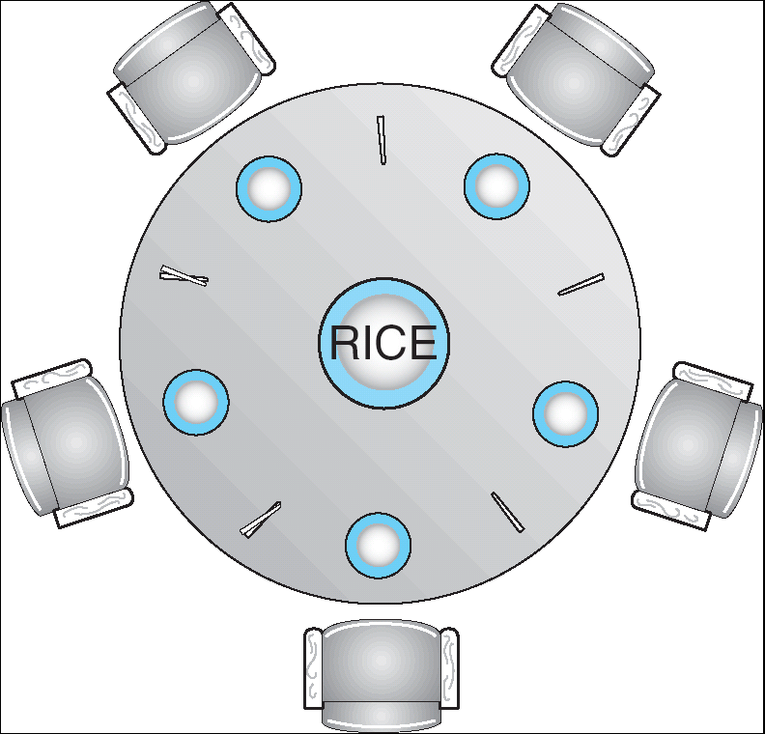
Dining-Philosophers Problem
Shared data
Bowl of rice (data set)
Semaphore chopstick [5] initialized to 1

Slide 26
Dining-Philosophers Problem (Cont.)
The structure of Philosopher i:
Do {
wait ( chopstick[i] );
wait ( chopStick[ (i + 1) % 5] );
// eat
signal ( chopstick[i] );
signal (chopstick[ (i + 1) % 5] );
// think
} while (true) ;
Problems!
Could cause deadlock

Slide 27
Problems with Semaphores
In-Correct use of semaphore operations:
signal (mutex) …. wait (mutex)
wait (mutex) … wait (mutex)
Omitting of wait (mutex) or signal (mutex) (or both)

Slide 28
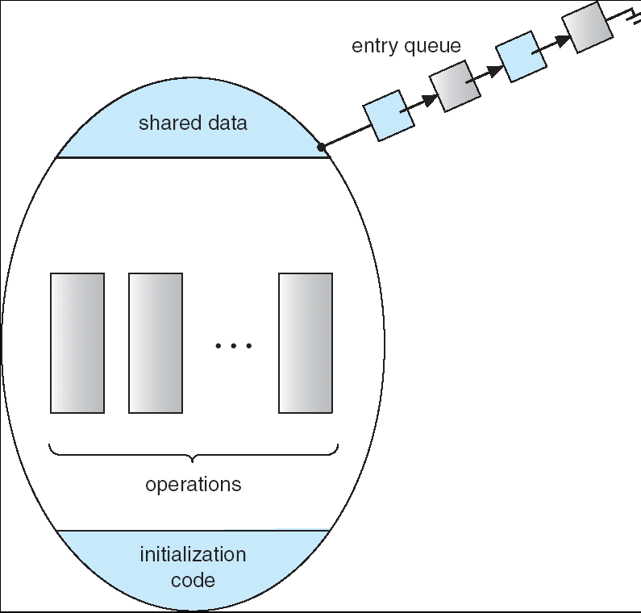
Monitors
A high-level abstraction that provides a convenient and effective mechanism for process synchronization
Only one process may be active within the monitor at a time
monitor monitor-name
{
// shared variable declarations
procedure P1 (…) { …. }
…
procedure Pn (…) {……}
Initialization code ( ….) { … }
…
}
}

Slide 29
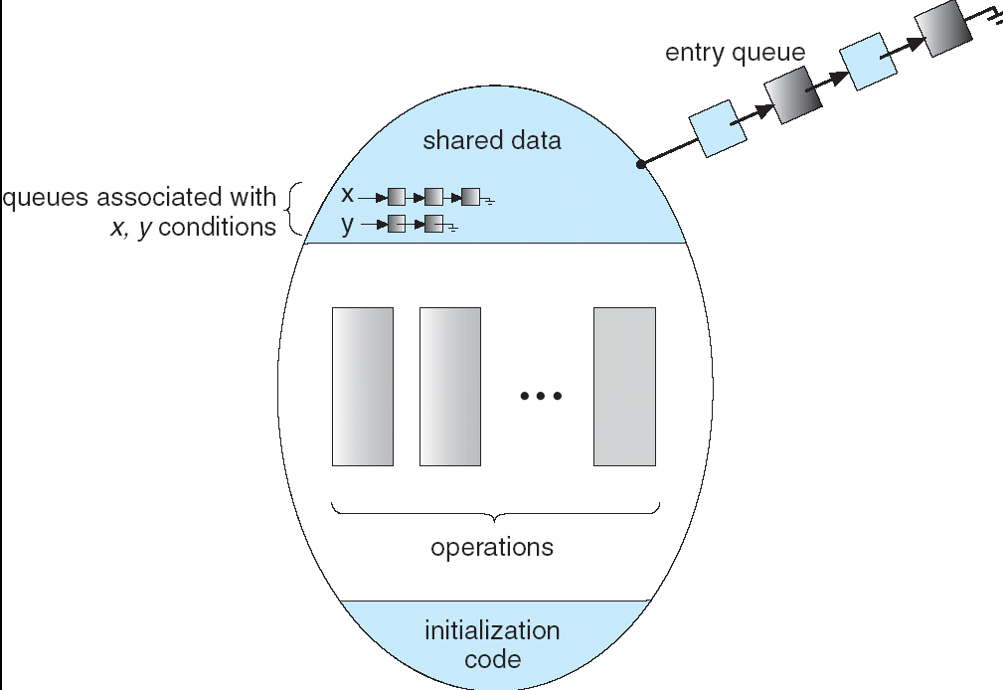
Condition Variables
condition x, y;
Two operations on a condition variable:
x.wait () – a process that invokes the operation is
suspended.
x.signal () – resumes one of processes (if any) that
invoked x.wait ()

Slide 30
Solution to Dining Philosophers
monitor DP
{
enum { THINKING; HUNGRY, EATING) state [5] ;
condition self [5];
void pickup (int i) {
state[i] = HUNGRY;
test(i);
if (state[i] != EATING) self [i].wait;
}
void putdown (int i) {
state[i] = THINKING;
// test left and right neighbors
test((i + 4) % 5);
test((i + 1) % 5);
}
void test (int i) {
if ( (state[(i + 4) % 5] != EATING) &&
(state[i] == HUNGRY) &&
(state[(i + 1) % 5] != EATING) ) {
state[i] = EATING ;
self[i].signal () ;
}
}
initialization_code() {
for (int i = 0; i < 5; i++)
state[i] = THINKING;
}
}

Slide 31
Synchronization Examples
Solaris
Windows XP
Linux
Pthreads
Android
Solaris Synchronization
Implements a variety of locks to support multitasking, multithreading (including real-time threads), and multiprocessing
Uses adaptive mutexes for efficiency when protecting data from short code segments
Uses condition variables and readers-writers locks when longer sections of code need access to data
Uses turnstiles to order the list of threads waiting to acquire either an adaptive mutex or reader-writer lock

Slide 32
Windows XP Synchronization
Uses interrupt masks to protect access to global resources on uniprocessor systems
Uses spinlocks on multiprocessor systems
Also provides dispatcher objects which may act as either mutexes and semaphores
Dispatcher objects may also provide events
An event acts much like a condition variable

Slide 33
Linux Synchronization
Linux:
disables interrupts to implement short critical sections
Linux provides:
semaphores
spin locks
Pthreads Synchronization
Pthreads API is OS-independent
It provides:
mutex locks
condition variables
Non-portable extensions include:
read-write locks
spin locks

Slide 34
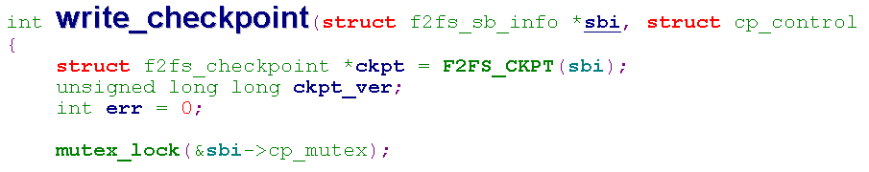
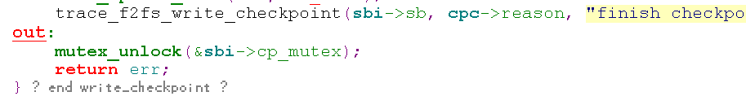
Android Synchronization
Disables interrupts to implement short critical sections
For example, write checkpoint
Start with mutex_lock()
Finish with mutex_unlock()

Slide 35
End of Chapter 6

